Slide 1
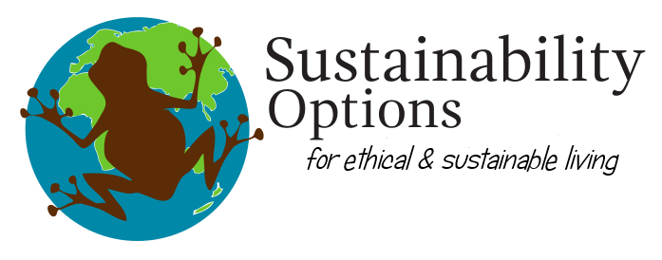

Healthier Whare,
Healthier Whenua
29th April, 2025, Huria Marae
Presented by Jo Wills, Sustainability Options
Funded by, The Resource Wise Community Fund
Ngā mihi to Huria Marae and team for hosting
Notes:
Tena koutou katoa, ko Jo Wills ahau.
Thank you to the teams at Huria Trust and Tahia te Marae for supporting this kaupapa and helping to make it happen. Sylvia has always welcomed Sustainability Options and myself to mahi alongside the whānau of the Ngati Ranginui
Towards healthier homes and we are grateful to be invited into this rohe.
Thank you to everyone in the team that I know, Lester, Kirsty, Makere, Maringi, Jamie, Nicole and everyone I haven’t met yet, thanks for helping this all come together.
Thanks also to Tauranga City Council who have funded us to put this session on. Funding has come through the Resource Wise Community Fund.
Some of you may be familiar with the mahi we do, supporting whanau towards warm, dry, healthy homes. We may have even visited some of your whare and carried out an assessment. Our core mahi is to provide sustainable living advice to anyone who asks, and we do have a particular focus on doing what we can to help whare and whānau be warm and dry. There is information in the resource bags about this service, and you can ask Nik or I about it during the break.
Tonight’s session is wānanga is also about a healthy home, and we are going to take a particular focus on what we can do to have a healthy whare, and healthy whenua that is free of waste. NEXT SLIDE

Slide 2
Kaupapa – sustainable household choices
Our health and wellbeing is connected to our whare
Our whare operates as a system, &
Our whare needs our help to provide a healthy environment
Everything is connected, we are part of the natural world
What we do matters

Slide 3
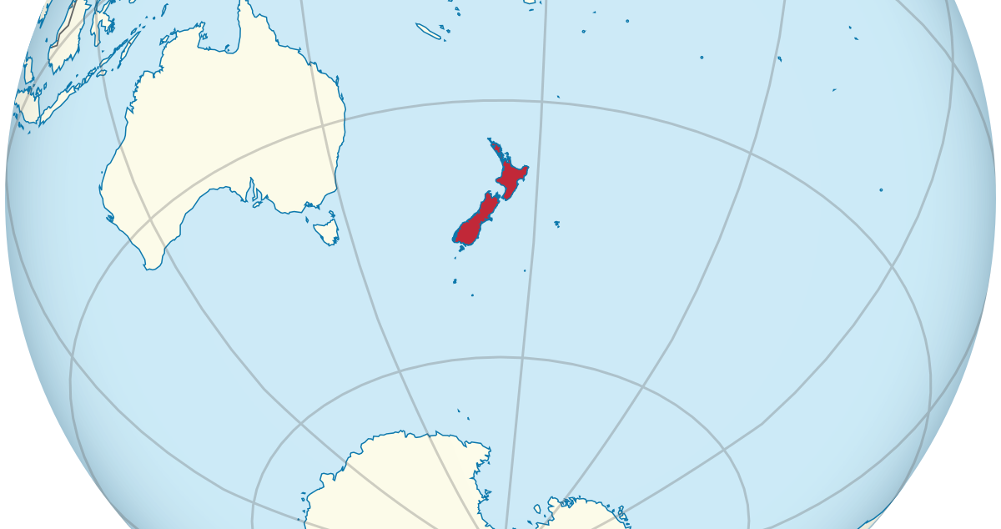
Our households produce more solid waste per person than any other OECD country, and only 35% of our waste is recycled and reused – one of the lowest rates in the world.
Household rubbish, if not managed properly can severely impact the environment through pollution of air, water, and soil, contributing to climate change, harming wildlife, and degrading ecosystems
Notes:
This wananga is about waste.
There is no such place as away for our waste, it goes into the land, sitting for 100’s of years. In Aotearoa, most landfills or dumps operate for about 20 years, a polyester shirt can take 200 years or more to decompose, tires can take hundreds or even thousands of years to decompose, plastic bottles can take 450 years to decompose, electronic waste can take over a million years.
Plastic is the most common material thrown away in 42% of households globally
Followed by food-rlated waste 38% of households
The waste we generate in our whare and the impact it has on us and on the whenua.
In nature, there is no such thing as waste, this is something we humans have created. Our households are one area we have control of with regards to waste. We choice what we bring into our house to support our lifesytle, and that choice dictates what leaves our house as waste. During this wananga we’ll break down the issues relating to common household waste items, including why they are a problem and what we can do differently. Tonights session is about providing information and awareness to support different choices.
We have a bad reputation for the waste we produce per person in this country.

Slide 4

Common household waste, outside and inside
Fridges
Mattresses
Tires
Scrap metal
Building materials
Green waste
Bedding
Clothing
Food waste
E-Waste
Energy
Water
Freezers
Washing machines
Driers
Notes:
These are the types of products and resources we will be focusing on tonight. We’ll start around the outside of the house and then have a break for kai at 5pm, then come back and talk about what goes on inside the house.
The hope for this wānanga is that everyone here can take away something to do differently, based on shared knowledge of what we could do differently.
I have a resources bag for those who have come along tonight, one per whare, and I’ll talk through what’s in them at the end.
I have also provided a reference guide for you to take home, so you know where to take things, should you have something lying around that after tonight, you would now like to see put to good use. And I have an feedback form, which I would really appreciate you filling out at the end and leave with me.

Slide 5
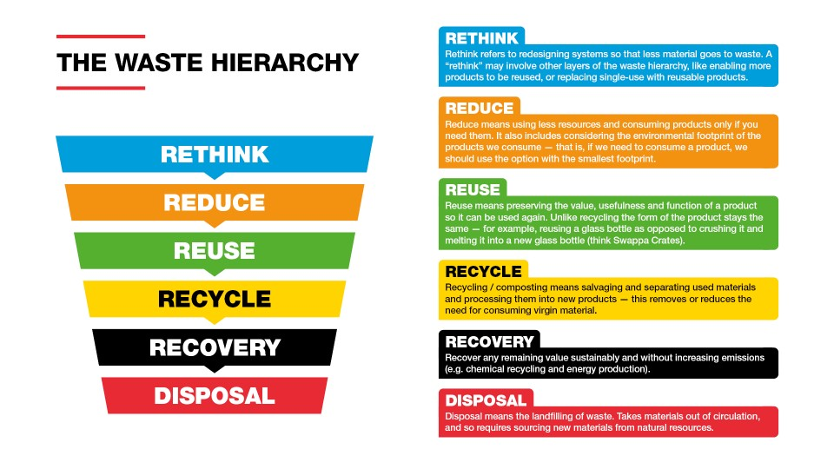

Notes:
The waste hierachy is based on the focus with the biggest priority at the top, that will have the most impact on reducing waste.
Notice how far down recyling is – while we’ll talk a lot about recycling tonight, it comes with a cost. Recycling involves breaking a product down, which uses energy, (more resources) and then uses the raw materials to create a new product. Sometimes this is upcycling, creating a product worth more than the original, sometimes its downcycling, creating a product that’s worth less.
However, the biggest impact we can all have is through reducing and reusing waste and thinking about what it is we actually need, and how we can make do with less, or hold onto quality things for longer.
Ready to jump into this?

Slide 6
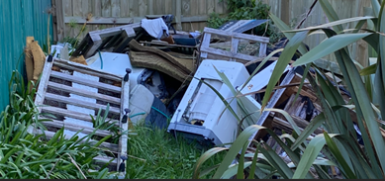
Whiteware & appliances
Tires
Scrap metal
Mattresses
Timber and building materials
Notes:
This is something we see regularly. Making no assumptions that this is what’s happening at your house, but even from my own experience, its easy for things to build up and then become overwhelming. We just moved house and the amount stuff we had collected over the 18 years we’d been in the same house was quite something. Many of us have a habit of ‘holding on to stuff’ just in case we need it further down the line, or worse still, which I am guily of hlding on to suff simply because we don’t know what to do with it. So stuff gets stored.
The problem with this sort of stuff is it can do a lot of harm to the soil and pose a health risk to us and our whānau. Not to mention, all of this was once worth something and in some instances, will still be worth something. All of the resources we use come from the earth resources.

Slide 7
Impact of whiteware and appliances left on whenua
Leaching in the soil
lead and lead compounds (in circuit boards)
cadmium (used as a stabiliser in plastics)
hexavalent chromium (is used as a corrosion inhibitor)
oils and greases (from fridges and other appliances)
Releasing into the air
chlorofluorocarbons (CFCs were the refrigerant and the gas in the cells of the insulation in refrigerators and freezers pre-1995);
hydrochloroflurocarbons (HCFCs are the refrigerants used in air conditioners which are only being phased out now);
brominated or halogenated flame retardants
Rust
Notes:
These are some of the things that can come out of whiteware.
Cadmium exposure can lead to various health problems, including kidney damage, lung cancer, and other health effects, depending on the level and duration of exposure. Exposure can occur through inhalation of dust and fumes, ingestion of contaminated food or water.
Lead poisoning can cause headaches, numbness in fingers and hands, depression, memory and sleep issues, intestinal issues, can also affect your blood, kidneys, bones, heart or reproductive systems…. Lead gets into your body through food, water and air.
If whiteware if left outside to deteriorate, these compounds can leach in the soil, we might decide at some point to turn that part of our yard into a garden…
Often the reason we dump our whiteware like this is because it breaks and we don’t know what to do with it. The tempation and in many cases necessity to buy cheap appliances has a long term cost for us and for the environment. Buying cheap often means the products will cost more to repair than to buy new, which doesnt make any sense. Cheaper products don’t last as long as better quality...if a cheaper model for aroudn $400 dollars need to be replace every 5 years, and a midrange $800 one lasts 8 -10 years, you’re better off.

Slide 8
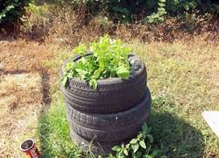
Impact of tires left on whenua
Significant risk if ignited – fire smoke and run-off contains a wide range of toxic and carcinogenic compounds (dioxins, furans, mercury and lead) – could lead to evacuation and contamination of soil and water supplies.
Provides a breeding ground for mosquito and rodents
Leaching of cadmium, lead, aluminum, manganese and zinc
Toxic to some fish species, intevertrates and algae
Never grow edible plants in tires
Notes:
6.5 million tyres are disposed of each year...they are a major fire and environmental disaster risk if not managed properly. Just like whiteare, they don’t belong left on our properties, because they do leach contaimanents in the soil.
For this reason never grow edible plants inside tires.

Slide 9

What to do with old tires & whiteware
Te Maunga Transfer Station charges a $30 fee to recycle whiteware if no longer working
The Salvation Army will offer a free pick up service if whiteware is still in good working order
Te Maunga Transfer Station accepts up to 5 clean tires (free of charge) per customer
Notes:
There are options for both!

Slide 10



Tyrewise
If you take your tyres to Te Maunga Transfer station they will end up as:
Fuel for Golden Bay Cement’s cement kiln. Alongside wood waste, the tyres burn clean because they can get the kiln to a very high temperature
Granulated rubber for artifical sports fields and equestian areas
Safety surfacing products like underneath jungle gyms

Slide 11
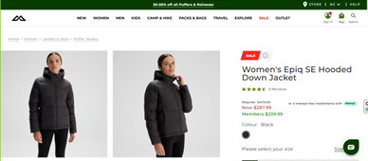
‘The buttery-soft outer fabric is made from recycled plastic waste, including end-of-life tyres.’
Notes:
Kathmandu
End of life tires can provide a number of useful and practical other products and if we are only dealiing with a few at a time – it costs us nothing to take them to Te Maunga.

Slide 12
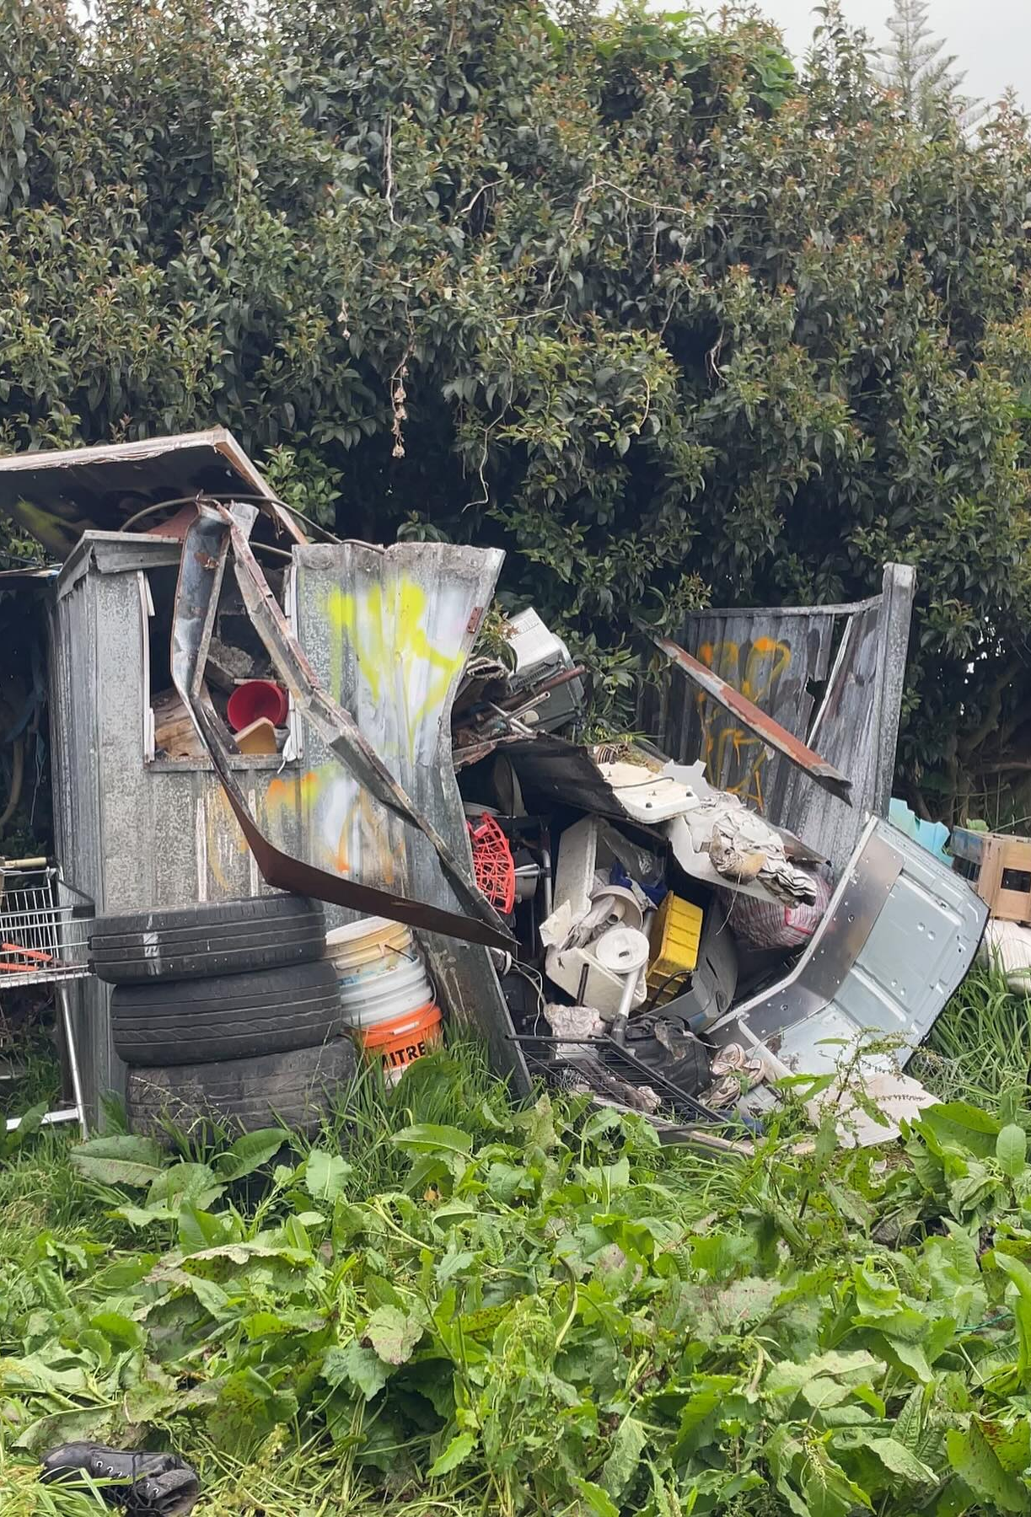
This is worth something
Notes:
Not only is it worth something to you from a recovery and recycling perspective, it comes with an environmental cost from the natural resources being extracted and manufactured, then transported...there is value in its resource, long after our use of the materials are gone.

Slide 13
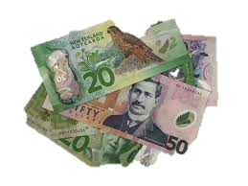

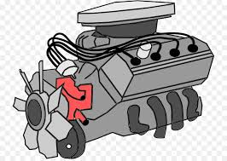
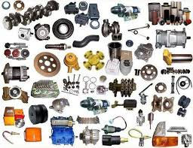
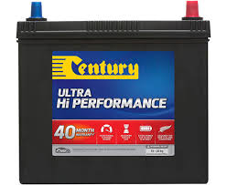
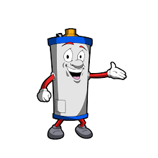
Scrap metal =
A lot of the scrap metal we lying around our place rusting, creating breeding ground for mosquitos and other bugs is actually worth something. Take it to a local scrap metal recyclers
Notes:
Cars, car parts, engines, batteries, hot water cylinders, steel, aluminum....so much resource that we think has reached its end of life and is now just a nuisance for us is still worth something.
In your reference guide there is a page that lists all the local scrap metal recyclers, who will pay you money for all those old car parts!
Older hot water cylinders are often made with a copper internal cylinder, copper is worth a lot of money.
We took a keep of old aluminum to the recyclers a couple of weeks ago and received $108 – that was worth the petrol used to take it there and it probably would have cost us the same or more to have taken it to the dump and this way, its being recycled into something else.
Every time we take scrap metal to the recyclers it gets broken down, often melted down and made into new raw materials for various industries.
Metal recycling conserves natural resources, reduces energy consumption associated with mining and refining, and lowers greenhouse gas emissions.
And…you are the ones who get paid for it.
Not all scrap metal will have a value – some stuff you might take will be collected, but the value is too low to pay you anything, but it will still be put through a recycling process, so its still worth it from a environmental perspective

Slide 14
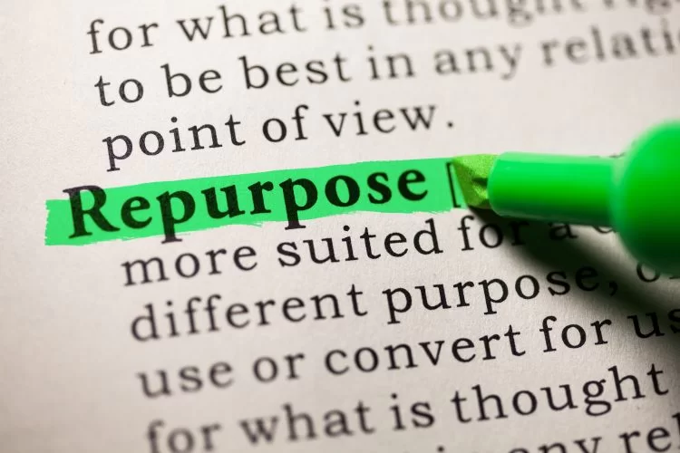
Mattresses, building materials, timber
Notes:
Repurposing means giving whatever it is that you don’t need any more, a new chance.
Its different from recycling.
Recycling takes energy, and costs money to break a product down and remake it.
A lot of stuff we have lying around, especially old timber and other building materials can be repurposed. This simply means the material will be used in its same form, for the same purpose, which is better than sitting in your back lawn.

Slide 15
Repurposing or Reusing
Building materials can have multiple lives if still in good condition i.e., minimal damage, no rot, no rust.
There are places in the Western Bay of Plenty that will take quality materials such as Te Puke Recycing Centre and the Katikati Recycling Center
If the materials are at the end of their life, many can be recycled at Te Maunga Transfer station (there is a fee by weight).
There are many places in the Western Bay of Plenty that will take scrap metals and often pay you for this, some provide pick up.

Slide 16
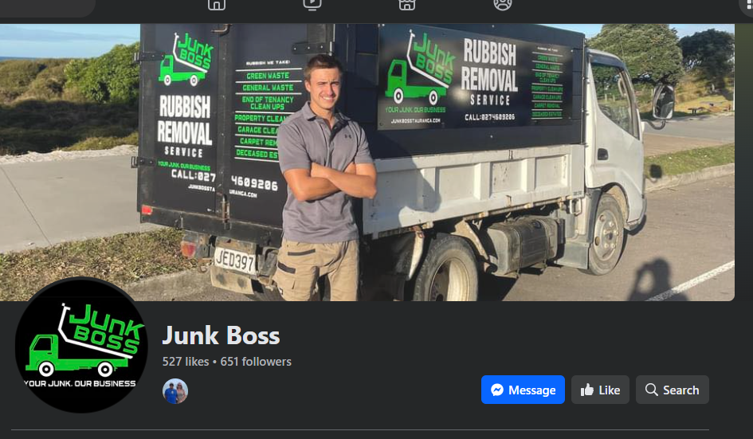

Very cool local service
Waste removal professionals who will clear all your waste/resource – for a fee

Slide 17
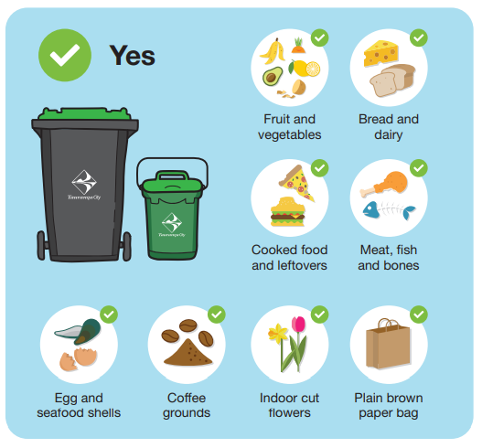
Green waste = compost
Notes:
Green waste (from our gardens, trees and food) is a majpor issue globally and here in Tauranga. However there really isn’t anything we have that needs to be ‘thrown away’.
Even meant and bones can be sent to composting.

Slide 18
Biogenic methane
Biogenic methane is produced by green waste as it breaks down, when its left to decompose in the absence of oxygen...this will happen if green waste is mixed in with other waste.
Methane is a harmful green house gas, causing up to 80 times more damage than carbon dioxide – we have a responsibility to do what we can to reduce this GHG
Composting reduces emissions by promoting an oxygen rich (well-aerated) decomposition process.
Household composting or taking large green waste to the transfer station is the better option than combining it with general waste
Notes:
This is the reason why we need to amke sure our green waste is managed in the right way

Slide 19
Key take aways
Leaving waste outside around your house will negatively impact the whenua
Leaving waste under your house isn’t good either. This will trap moisture and contribute to mould inside your house
There are many opportunities to help you deal with waste, some of it will cost, some of it will be free.
Buying well can reduce your waste because quality products last longer, saving money in the long run.

Slide 20
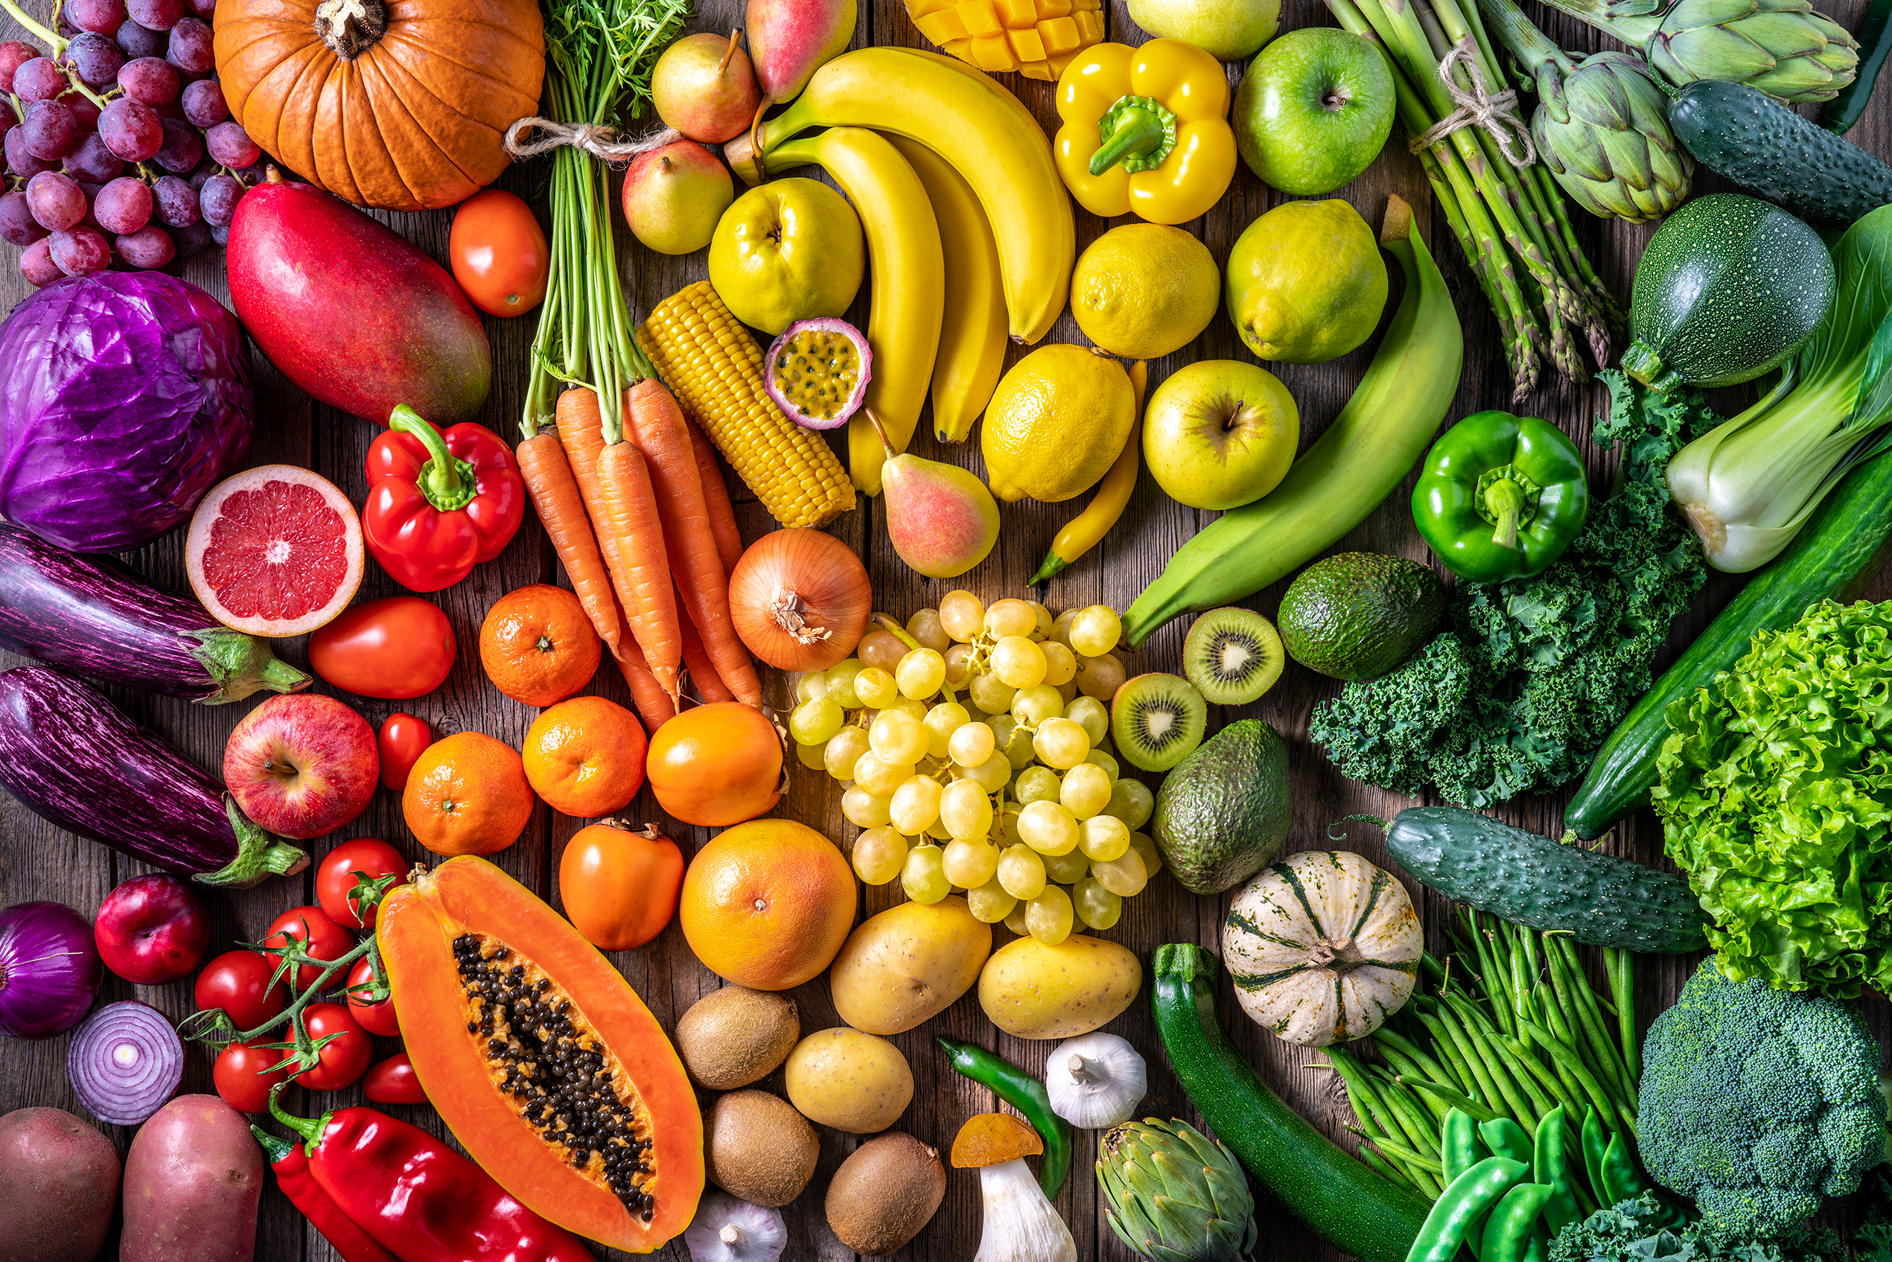
Break for kai
Notes:
After kai, we’ll come back to together and think about the waste we have in our home

Slide 21
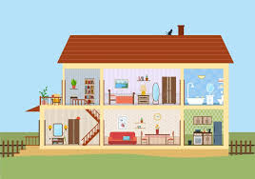
Inside the whare

Slide 22
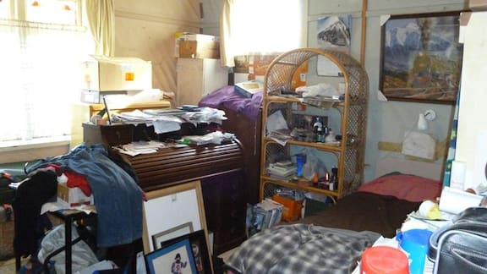
What we do matters
Notes:
Having a lot of stuff build up inside our house can also cause problems.
We all have a lot of stuff, myself included, too much stuff, sentimental stuff, but when that stuff starts to take over our spaces, it needs to be dealt with.

Slide 23
The dark side of clutter
Risk of trips and falls in the home
Build up of clothes and bedding on floors will trap moisture, contributing to dust mites and mould (synthetic fabrics ‘sweat’)
Can attract other pests such as cockroachs, mice and rats, especially if food is involved
It can contribute to stress, anxiety and depression
It’s wasted resource – all items come with an environmental cost

Slide 24
4 ways to reduce householder clutter
‘Spring’ clean wardrobes, making sure any good quality, clean clothes that are no longer wanted, to go charity shops, donate to Woman’s Refuge
The SPCA accepts old towels, sheets, duvet covers and blankets (especially polar fleece)
Lots of migrant families start out with very little therefore good quality kitchen items & furniture can go to charity shops
Reduce what you buy…try to buy quality things that will last…more natural fibres for bedding and clothes, buy less single use plastic, buy less, buy well.
Notes:
Polar fleece blankets are cheap, and the SPCA likes them because they can be easily washed and they dry quickly...but they are not always the best solution for us.
Synthetic fibres, like polar fleece, which is just polyester, which is essentially plastic, don’t breath when on our beds or our skin, so they sweat. For our winter warmth, wool is great because its long lasting, breathable and will naturally breakdown when its at end of life. Good quality woollen products can often be found at Op Shops.
Op shops aren’t dumping grounds, it things are broken, too old for use, mouldy or damaged, the op shop isn’t the place for them

Slide 25
Food waste is a waste!
We know that biogenic methane is caused by decomposing food when its thrown in with general waste
Food uses a lot of the earths energy to grow and produce
Food costs us a lot to buy, so why do we throw our money away
Notes:
Already mentioned this before we had kai.
Every year Kiwis' waste $2.9 billion dollars worth of food. That's $1,326 per household, per year.

Slide 26
Ideas to reduce food waste
Know the difference between use by and best before
Freeze food before its use by date to prolong its life
Best before is a guide, you can still eat food after the best before date
Store food correctly so it doesn’t spoil
Plan your food spend and try not to shop hungry
Keep a container in the fridge for garlic, onion and carrot skins, bits of celery, for homemade stock
Use leftovers for lunch
Use bread custs
Anything you can’t eat, compost or feed to the chickens
Before you buy more food, do a fridge clean up and eat what’s in there first

Slide 27
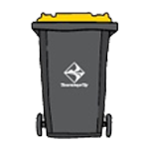
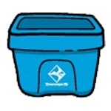
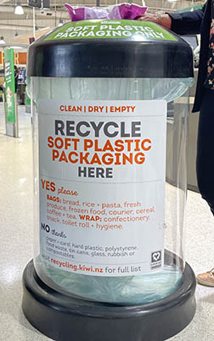

Household recycling in Tauranga
clean paper and cardboard (no paper towels, tissues, or shredded paper)
washed plastic bottles, trays and containers numbered one, two and five (may be written as 1 or 01, 2 or 02, and 5 or 05)
washed food and drink cans and tins (metal and aluminum).
No lids, caps or aerosol cans in your yellow-lidded recycling bins.
glass bottles and jars that have been rinsed and had lids removed.
Other glass like heatproof glass (broken Pyrex jug or mixing bowl), window glass, medicinal glass or lightbulbs cannot be recycled and should be wrapped in newspaper and placed in your red-lid rubbish bin.
These are things like chip packets, bubble wrap, bread bags, toilet paper packaging – anything that you can scrunch up in your hand. Recycling bins are in most Woolworths, New Worlds and The Warehouse.
Notes:
Soft plastic recycling turns plastics into planter boxes or fence posts.
estimated that Aotearoa only has the capacity to recycle around 700 tonnes of soft plastic over the next year.
All plastics numbered 1-7 are accepted for recycling, excluding polystyrene and meat trays, but how they get to be recycled is another story; we can only put Plastics 1, 2 + 5 in our domestic recycling bins.
Some of New Zealand’s recycling is done here as well as Asia and Australia
Cardboard and glass are generally converted into new products here in NZ
Plastic, paper and metal are sent overseas for re-manufacture
Under Section 23(1)(b) of the Waste Minimisation Act 2008, plastics will be gradually phased out. Some items we can kiss goodbye to are: PVC meat trays, Polystyrene packaging, EPS grocery packaging, oxo-degradable and photo-degradable plastics, plastic drink mixers, plastic cotton buds
The recyclability of a product depends on how it is made; plastics that have been thermoset contain polymers that have formed irreversible chemical bonds - therefore cannot be recycled.
Thermoplastics can be re-melted and re-molded to create a new product.

Slide 28

eWaste –
What resources are used to make a mobile phone?
Metals
Aluminium: Used for the phone's casing and various components.
Copper: Used for electrical connections and wiring.
Gold: Used for circuit boards due to its conductivity and chemical stability.
Lithium: Essential for rechargeable batteries.
Cobalt: Also used in batteries to extend their life.
Nickel: Used in electrical connections and batteries.
Silver: Used for circuit boards.
Tin and Lead: Used in solder to join components.
Palladium and Platinum: Used for electrical connections on circuit boards.
Tungsten: Used for vibration motors.
Rare Earth Elements: Like Neodymium, used in speakers and other components.
Non-Metallic Metals
Glass: Used for the screen.
Plastics: Used for the casing and various components.
Silicon: Used in semiconductor chips for the phone's processing power.
Fibreglass: Used in circuit boards.
Graphite: Used in battery anodes.
Indium: Used in touchscreens.
Sand: Used to make glass and semiconductors.
Notes:
Look at what comes out of the earth to go into a mobile phone, and then what do we do with the old one when the latest model comes out?

Slide 29
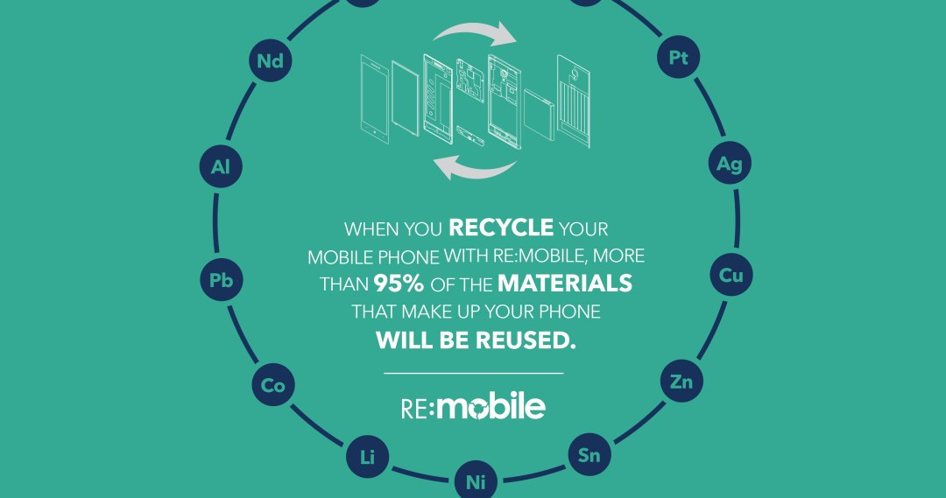
Notes:
You can recycle your mobile phones at the Te Maunga transfer station!
Along with pretty much all of your other e-waste (laptops, screens, TV’s, cameras, small electrical appliances)

Slide 30
Key Takeaways
We all buy too much stuff. Stuff on sale, stuff we think we’ll use but don’t, stuff that’s in fashion…we need to stop buying so much stuff.
Clutter inside our house can have a negative impact on our house and health, give away what you don’t use or need.
Throwing food away is a waste. Compost any food you can’t eat.
A lot of plastics can be recycled in Tauranga.
E-Waste and small electrical appliances can also be recycled

Slide 31


Energy and water
Have shorter showers and fix dripping taps and pipes, especially if they’re hot water
Switch off any appliances that you’re not using at the wall
Turn off lights in the rooms you’re not using
Turn off fridges or freezers that aren’t essential
Try to replace all your older lightbulbs with LED bulbs
If you can, insulate your electric hot water cylinder; wrapping it with an old duvet inner works
Check out powerswitch.org.nz to see if you’re getting the best deal

Slide 32
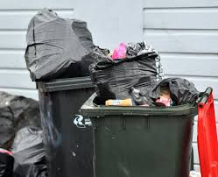
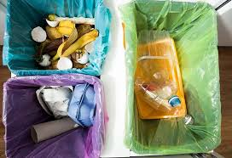
If we can all go from this to this...we all win
Notes:
Reducing our waste in our homes helps us, our whānau, the taiao, it takes pressure off the land, and by keeping resources in circulation for longer by reusing, repurposing
And recycling, we are reducing the amount of natural resources being used to make things. We all win.

Slide 33
What’s in the resource bag?
Reusable Bamboo wipes | Great and very cost effective replacement for paper towels. Retail around $9.99. 20 on a roll and each can be washed 85 times!
Soap tablets and dispensers | Cost effective and reduces enormous amounts of plastic packaging when purchasing liquid soap. $12 for a 3 pack, 2 tablets make 250mls of soap. Liquid soap is also very heavy when transported so has high transport emissions.
Beeswax Wraps | These can be used in place of glad wrap for sandwiches, pieces of cake or slices. They can be washed and used over and over again. Saves loads of plastic waste.
Reusable Bin Liner | Use in your bin instead of plastic bags, wash and reuse, saving loads of plastic waste.
Bamboo cotton buds | These are bamboo sticks instead of plastic so will break down. $5.20 for 200 or Swisspers $4.99 for 240 from Woolworths
Seed Bombs | Throw in your garden for the bees.
Hygrometers | For measuring the humidity and temperature in your house. Important for understanding when to ventilate and when to heat.
Notes:
The purpose of this bag was to hopefully introduce you to some useful and reuseable products that you may not have been aware of.

Slide 34
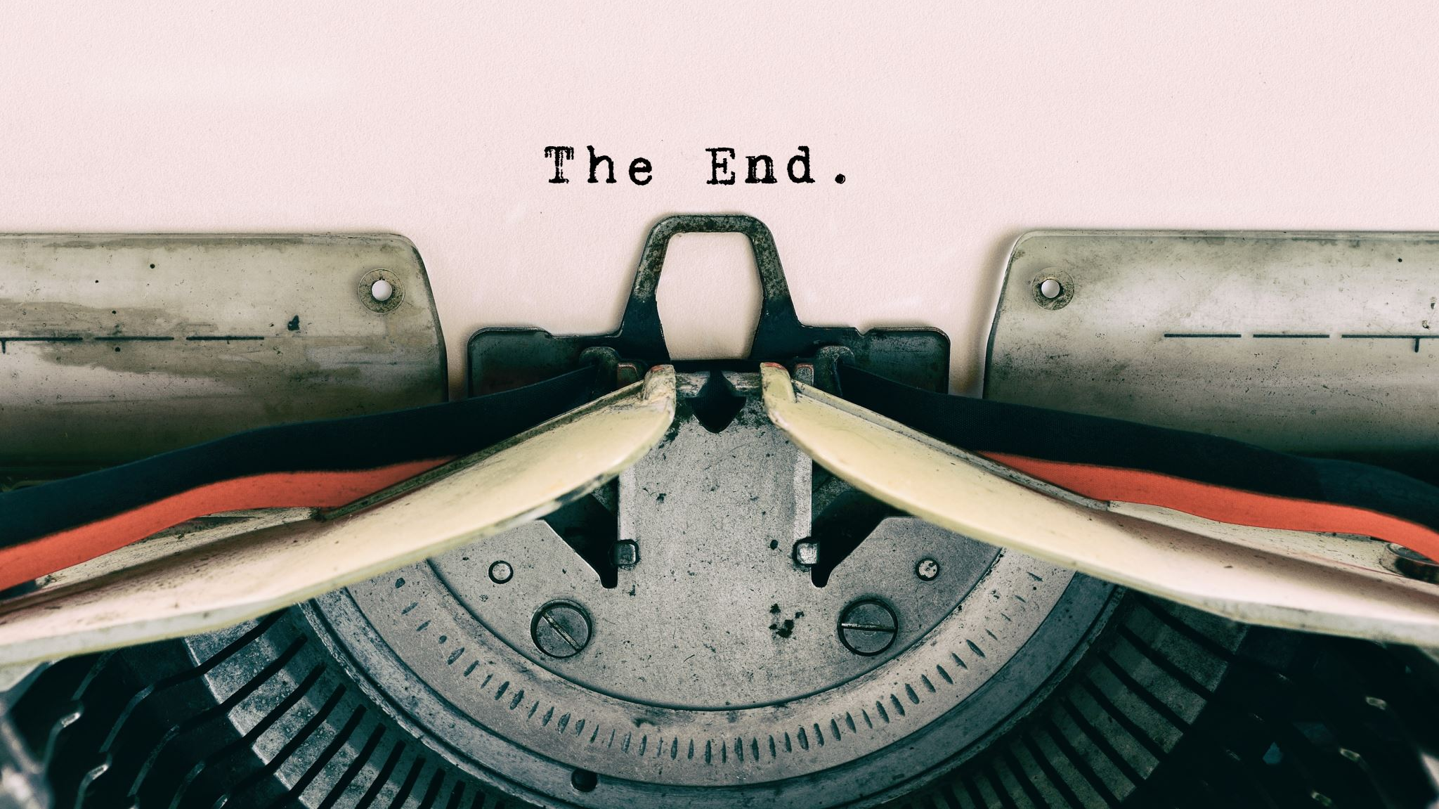
Thank you for coming along!
Notes:
Evaluation forms!

